Slide 1
Class 7 – Costs of Financial Distress

Slide 2
“Pie” Theory
D
E

Slide 3
“Pie” Theory
E
D
Destroyed in Financial Distress

Slide 4
What is financial Distress
Financial Distress – Cash flow < current obligations
  In-court or out-of court
  Liquidation, exit or restructuring/reorganization
Depends on three letters:
  D = amount of obligations
  V = going concern value of the firm
  L = liquidation value of the firm
➔

Slide 5
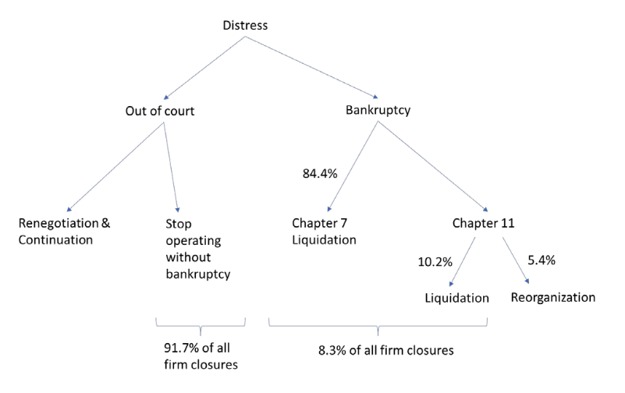
Financial distress triage flow-chart

Slide 6
Financial distress triage flow-chart
V<D
L<V
V<L
V<L
V<L
V>L

Slide 7
What are costs of financial distress?
CFD = additional cost incurred from not meeting payment
  Financial distress ≠ economic distress
  Value loss coming in excess of economic distress
  Can be reduced by reducing debt obligations
    While economic distress is not affected by capital structure
→ examples

Slide 8
Direct costs of distress
Direct fees paid in distress
  Penalties to debt holders
  Administrative & legal fees
Of course, this is small
  1-5% of bankruptcy processes
  In expectation, has to be x by proba of distress, even smaller
Cannot explain why firms stay far from infinite leverage
  debt ratios typically < 50% except in banking
  There has to be other costs

Slide 9
Plan of attack
Indirect costs of financial distress
  Debt overhang
  Gambling for resurrection
Optimal capital structure: trade-off theory

Slide 10
Costs of Financial Distress: indirect

Slide 11
Indirect Costs of Financial Distress
  1. Loss of customers
  Higher costs for which types of products?
  2. Fire sales of assets
    Higher costs for which types of assets?
  3. Loss of employees
    Higher costs for which types of firms?

Slide 12
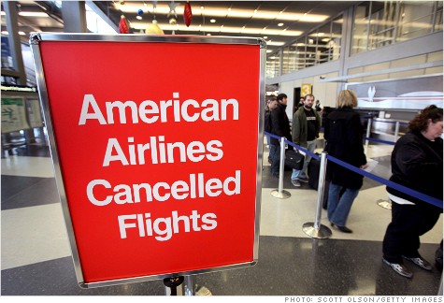
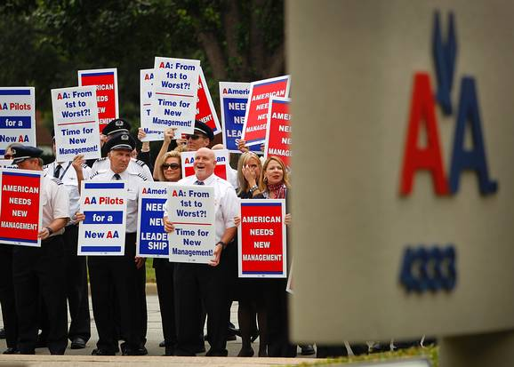
Indirect Costs of Financial Distress
Nov 2011: AA files for bankruptcy, enterprise value = $90m
  Time to renegotiate with unions → strikes
Fall 2012: customers are getting angry
  50% of the flights are delayed, 3% are cancelled
  AA’s passengers ↓ 4%
"If someone has to be somewhere for a meeting, there's no way I can take a chance and book American" (one entrepreneur)

Slide 13
Indirect Costs of Financial Distress
  “debt overhang”
    Pass up valuable projects bc creditors are senior
    Competitors may take this opportunity to be aggressive
“gambling for resurrection”
  Shareholders take on too many projects b/c they don’t bear downside risk

Slide 14
Debt overhang

Slide 15
Debt Overhang Problem: Numerical Example
Longfellow Inc.’s assets are worth:
Longfellow has a new investment project:
  Today: investment outlay $15.
    Next year: safe return $20
    Discount rate = 0% (example does not need risk aversion)
Assume Longfellow is 100% equity financed, should it undertake the project?

Slide 16
Debt Overhang Problem: Numerical Example
Longfellow Inc.’s assets are worth:
Longfellow has a new investment project:
  Today: investment outlay $15.
    Next year: safe return $20
    Discount rate = 0% (example does not need risk aversion)
Assume Longfellow is 100% equity financed, should it undertake the project?
NPV = (120+30)/2 - 15 – (100+10)/2
= 20-15 = 5

Slide 17
Debt Overhang Problem: Numerical Example
Assume that Longfellow has debt with promised repayment $40 due next year.
  Write payoff tree to shareholders without the project:
  Write payoff tree to shareholders with the project:
Will Longfellow’s shareholders fund the project?
Assume now Longfellow issues debt, senior to existing debt, in order to fund the project
  Debt = “we will pay you D if our cash-flows are greater than D, and all of our cash-flows otherwise”
  Existing debt gets 40 if there are enough cash-flows left, and all cash-flows otherwise.
  Assume new debt lenders just break even: what is D?
  What is the payoff to shareholders
  What is the payoff to existing debtholders? Do they agree?ΔE = 10 – 15 <0 ; no !

Slide 18
Debt Overhang Problem: Numerical Example
Assume that Longfellow has debt with promised repayment $40 due next year.
  Without the project:
    E = (60+0)/2=30
    D = (40+10)/2=25
  With the project:
  E = (80 + 0)/2=40
  D =(40+30)/2=35
Will Longfellow’s shareholders fund the project?
  ΔE = 10 – 15 <0 ; no !

Slide 19
Debt Overhang Problem: Numerical Example (2)
Assume that Longfellow has debt with promised repayment $40 due next year.
  Without the project:
    E = (60+0)/2=30
    D = (40+10)/2=25
  With the project:
  E = (80 + 0)/2=40
  D =(40+30)/2=35
Will Longfellow’s shareholders fund the project?
  ΔE = 10 – 15 <0 ; no !

Slide 20
Debt Overhang Problem: Numerical Example (3)
Would new junior debtholders lend to finance the project ?
  No: (D’+0)/2 = 15 → D’=30 → ΔE of doing this = -30 + (40-D’/2) = -5 <0
What is happening ?
  Existing debt = tax on investment returns
  “debt overhang”
Solution ?
  Issue new senior debt: D’=15 → ΔE = -30 + (120-40-15)/2 = 2.5! Go
    Existing debt ΔD = (40+15)/2 – (40+10)/2 = 2.5 . Debtholder is ok
  Restructuring : Reduce face value of debt to 28 under the condition that new shareholders invest 15.
    ΔD = 28 – 25 >0
    ΔE = (92+2)/2 – 30 – 15 = 2 >0

Slide 21
Debt Overhang Problem: Numerical Example (3)
Would new junior debtholders lend to finance the project ?
  No: (D’+0)/2 = 15 → D’=30 → ΔE of doing this = 0/2+(20-D’)/2 = -5 <0
What is happening ?
  Existing debt = tax on investment returns (ΔD = 20/2 = 10 > 0 )
  “debt overhang”
Solution ?
  Issue new senior debt: D’=15 → ΔE = 0/2 + (20-15)/2 = 2.5! Go
    Existing debt ΔD = (15-10)/2 + (0)/2 = 2.5 . Debtholder is ok
  Restructuring : Reduce promised repayment to 28 if new shareholders invest 15.
    ΔD = 28 – 25 = 3 >0
    ΔE = (2)/2 + (92-60)/2 – 15 = 2 >0

Slide 22
Gambling for resurrection

Slide 23
Gambling with Debtholders’ Money: An Anecdote
“When Fred Smith first started FedEx, he struggled desperately to make payroll. At one point he raided the family trust fund without his sisters’ permission (they later sued him) and was forced to keep borrowing money to cover his costs. Finally, the bank in Chicago that had been lending him money said enough—we’re done, No more loans. Smith found himself at O’Hare airport facing the trip back to Memphis knowing he would have to tell his employees that it was over. He simply didn’t have the money to pay them. As he looked up at the departure board for the status of his flight home, he noticed that a flight was leaving soon for Reno. Instead of going to Memphis, he went to Reno and took all the remaining money he had (insufficient to cover the next month’s salaries but still something) and began gambling. (It may have been roulette, but I don’t remember.)
Fortunately, for those of us who often want to get a package somewhere overnight, he had a run of good fortune at the gaming tables, enough to cover the next month’s salaries. During that time, revenue picked up and FedEx survived and ultimately thrived.
I suspect Fred Smith doesn’t spend a lot of time gambling (at casino odds, anyway) with the revenue of FedEx. But facing extinction, he became quite a risk-taker.”
Source: Russ Roberts’ Blog.

Slide 24
Excessive Risk Taking: a numerical example
Your firm has $100 in cash.
You have the opportunity to acquire an internet start-up for $50.
  The start-up will either be worth $0 (prob = 2/3) or $120 (prob = 1/3) in one year.
  Assume the discount rate is 0%.
Would you invest in the start-up if your firm is all-equity financed?
What if the firm has debt outstanding with promised payment=$80?
($80 is the promised repayment, not the value of debt!)
If all equity:
Expected payoff = 0.66 × 0 + 0.33 × 120 = $40
NPV = -50 + 40 = –$10 → Reject!

Slide 25
Excessive Risk Taking: a numerical example
Your firm has $100 in cash.
You have the opportunity to acquire an internet start-up for $50.
  The start-up will either be worth $0 (prob = 2/3) or $120 (prob = 1/3) in one year.
  Assume the discount rate is 0%.
Would you invest in the start-up if your firm is all-equity financed?
What if the firm has debt outstanding with promised payment=$80?
($80 is the promised repayment, not the value of debt!)
If all equity:
Expected payoff = 0.66 × 0 + 0.33 × 120 = $40
NPV = -50 + 40 = –$10 → Reject!

Slide 26
Example, cont.
If leveraged (debt promised repayment =$80):

Slide 27
Example, cont.
If leveraged (debt promised repayment=$80):
Without project: value of equity = $20, value of debt = $80
Lucky (p=1/3)
V=$170
E=$90 D=$80
With project
Unlucky (p=2/3)
V=$50
E=$0 D=$50
With project: value of equity = $30, value of debt = $60
→ shareholders go for it
→ they gain $10 although debtholders lose $20

Slide 28
Excessive Risk-Taking
The project is a bad gamble (NPV<0) but the shareholders are essentially gambling with the creditors’ money.
Implication: Firms in distress will adopt excessively risky strategies to “go for broke”.
Solution: restructuring. Assume debtholders swap their claim into a 69% equity stake
  The firm is all equity financed: NPV<0 projects are not taken
  So debtholders get 69 as their new stake, existing shareholders: 31
  Shareholders accept (currently make 30 if they gamble)
  Debtholders find it profitable as they would only get 60 in case of gambling
  ➔ Debtholders optimal reduce the face value – it avoids risk-taking

Slide 29
Excessive Risk-Taking
The project is a bad gamble (NPV<0) but the shareholders are essentially gambling with the creditors’ money.
Implication: Firms in distress will adopt excessively risky strategies to “go for broke”.
Solution: restructuring. Assume debtholders swap their claim into a 69% equity stake
  The firm is all equity financed: NPV<0 projects are not taken
  So debtholders get 69 as their new stake, existing shareholders: 31
  Shareholders accept (currently make 30 if they gamble)
  Debtholders find it profitable as they would only get 60 in case of gambling
  ➔ Debtholders optimal reduce the face value – it avoids risk-taking

Slide 30
Optimal capital structure

Slide 31
Tradeoff theory : optimal capital structure
According to the tradeoff theory, debt finance has both benefits (tax shields) and costs (expected costs of financial distress). Combining these benefits and costs we have:
Value (levered firm) = Value (unlevered firm)
+ PV (tax shields)
– PV (expected costs of financial distress)

Slide 32
Practical Implications
Companies with “low” distress costs should load up on debt
  …. Unless they don’t benefit from tax shield (b/c/ local taxes, investors etc.)
Companies with “high” distress costs should be more conservative.
  Risky industry, risky strategy (MF case)
  Default-sensitive consumers (after sales, durable good etc)
  Default sensitive employees (rare talent, organizational capital, etc)
  Continuous need for external funding (innovation etc)
  Competitors rich enough to take advantage (MF case)
  Hard to avoid excessive risk taking (finance, real estate)

Slide 33
Summary
Theories of capital structure:
  MM as starting point: capital structure is irrelevant.
  What is missing from the MM view?
    Taxes.
    Costs of financial distress.
    Capital structure is not irrelevant.
    Tradeoff theory of capital structure.
Next session:
  Financial distress and bankruptcy: 6 Flags case
  Then: What is the role of asymmetric information?
  Intel case

